Slide 1
“ADAM’S KITCHEN”
IS 430: FUNDAMENTALS OF IT PROJECT MANAGEMENT
TEAM MEMBERS
SRINILAY JALAGAM
ADAM SLUTSKY
SHIBANI MARAN
KAUSHIK BANDARU
KSENIYA LISTAPAD
Adam’s Kitchen

Slide 2
Project Overview
TO CREATE A WEBSITE FOR THE RESTAURANT WHICH WILL BRIEF THE CUSTOMERS WITH THE INFORMATION ABOUT THE FOOD SERVED AND HOW THE PLACE LOOK LIKE TO DINE.

Slide 3
Project Requirements
EVERYONE SHOULD BE ABLE TO FIND THE WEBSITE WITH A SPECIFIC WEBSITE ADDRESS.
EVERYONE SHOULD BE ABLE EASY TO ENTER HOME PAGE.
THE WEBSITE SHOULD BE CUSTOMER-FRIENDLY, SO CUSTOMERS WILL NOT HAVE ANY COMPLICITY TO USE IT.
THE WEBSITE SHOULD HAVE AN ONLINE ORDER PAGE FOR FAST ONLINE ORDERS.
THE WEBSITE SHOULD CLEARLY PROVIDE LOCATION, HOURS, AND PHOTOS OF THE INTERIOR DESIGN OF THE PLACE.
THE WEBSITE SHOULD PROVIDE FAST ACCESS TO THE TABLE RESERVATION, REVIEW PAGE, AND HISTORY OF THE PLACE.

Slide 4
Deliverables of the Project
INITIATING AND PLANNING.
ECONOMICAL AND OPERATIONAL FEASIBILITY OF THE PROJECT.
DIVISION OF THE PROJECTS INTO INDIVIDUAL TASKS.
CREATING A COMMUNICATION PLAN.
IDENTIFYING THE RISKS OF THE PROJECT.
DEVELOPING A SCOPE STATEMENT.

Slide 5
Goal (vision) Statement
TO BUILD A WEBSITE FOR THE RESTAURANT THAT WILL EXCEED EXPECTATIONS AND FULLY SATISFY THE REQUIREMENTS OF THE CLIENT

Slide 6
Project Scope
Project Name: Adam’s kitchen
Date: 10/05/2019
Project Justification: To help “Adam’s kitchen” attract new customers and to increase the revenue of the restaurant by showcasing quality food images and ambiance of the restaurant in the website, which also helps attracts new orders via online
Project Description: This project is meant to serve as a website for Adam’s kitchen customers. It has the following functionalities: the ambiance of the restaurant, reservation of table, information on restaurant, online takeout.
Project Deliverable: A final website which is easy to access and user-friendly for all the customers and to boost the sales
Out of scope items: Not responsible for maintaining the website
Project Objectives: To build a website that promotes the restaurant food and services, and increases the revenue of the restaurant
Budget : $42,000.00
Schedule Objectives: 6 weeks project beginning from October 1st, and ending November 7th
Acceptance Criteria: To deliver a functional website that should cover all the use cases and provide an excellent customer user experience.
Constraints: non-availability of infrastructure and usage of bad quality food items
Assumptions: Interface will be a website The system will help the restaurant to attract customers

Slide 7
Risk Register
Rank | Name | Description | Risk Owner | Probability | Impact | Status
1 | Technical | Lack of technical Skills | Kseniya | 7 | 7 | 49
2 | Budget | Lack of the promised financial support | Kaushik | 6 | 8 | 48
3 | Unclear Requirements | Client is changing his mind on requirements | Adam | 6 | 7 | 42
4 | Deadlines | Missing deadlines | Adam | 4 | 9 | 36
5 | Collaboration | Some group members are not getting along | Shibani | 5 | 7 | 35
6 | Lack of Communication | Not enough meetings | Kseniya | 3 | 8 | 24
7 | Change in Responsibilities | Team members might swap their duties | Kaushik | 3 | 7 | 21
8 | Design | The design didn’t meet client expectations | Shibani | 2 | 6 | 12
9 | Perspective | Different views of the process between group members | Srinilay | 2 | 5 | 10
10 | External Factors | No funding | Srinilay | 1 | 10 | 10

Slide 8
Cost Estimate
Level Item | Item | Unit/Hrs | Unit Cost | Total | Calculate % of the cost allocated to each level item
1 | PM
 | PM | 200 | $80.00 | $16,000.00 | 33.14%
 | Project Team | 400 | $50.00 | $20,000.00 | 41.43%
2 | Hardware
 | Equipment | 3 | $300.00 | $900.00 | 1.86%
3 | Software
 | Development | 80 | $70.00 | $5,600.00 | 11.60%
 | Support | 30 | $30.00 | $900.00 | 1.86%
4 | Design Development | 20 | $40.00 | $800.00 | 1.66%
5 | Content Development | 20 | $20.00 | $400.00 | 0.83%
6 | Testing ( 10% of the total hardware and software cost) |  |  | $780.00 | 1.62%
7 | Flexible Account
 | Travelling | 1 | $1,000.00 | $1,000.00 | 2.07%
 | Training | 8 | $75.00 | $600.00 | 1.24%
 | Meetings | 10 | $50.00 | $500.00 | 1.04%
 | Administration | 20 | $40.00 | $800.00 | 1.66%
 | Total Project Cost |  |  | $48,280.00 | 100.00%

Slide 9
Budgeting over 6 weeks
Level Item | Item | 1 | 2 | 3 | 4 | 5 | 6 | Total
1 | PM
 | PM | $2,500.00 | $2,500.00 | $2,500.00 | $2,500.00 | $3,000.00 | $3,000.00 | $16,000.00
 | Project teams members | $3,300.00 | $3,300.00 | $3,300.00 | $3,300.00 | $3,300.00 | $3,500.00 | $20,000.00
2 | Hardware
 | Equipment |  | $300.00 | $300.00 | $300.00 |  |  | $900.00
3 | Software
 | Development | $800.00 | $1,300.00 | $1,300.00 | $1,500.00 | $700.00 |  | $5,600.00
 | Support |  | $200.00 | $200.00 | $200.00 | $300.00 |  | $900.00
4 | Design Development |  |  | $200.00 | $250.00 | $250.00 | $100.00 | $800.00
5 | Content Development |  |  |  |  | $200.00 | $200.00 | $400.00
6 | Testing (10% of the total hardware and software cost) |  | $200.00 | $300.00 | $280.00 |  |  | $780.00
7 | Flexible account
 | Travelling |  |  |  | $500.00 | $500.00 |  | $1,000.00
 | Training | $400.00 | $200.00 |  |  |  |  | $600.00
 | Meetings |  | $100.00 | $100.00 | $100.00 | $100.00 | $100.00 | $500.00
 | Administration |  | $160.00 | $160.00 | $160.00 | $160.00 | $160.00 | $800.00
 | Total Project Cost | $7,000.00 | $8,260.00 | $8,360.00 | $9,090.00 | $8,510.00 | $7,060.00 | $48,280.00

Slide 10
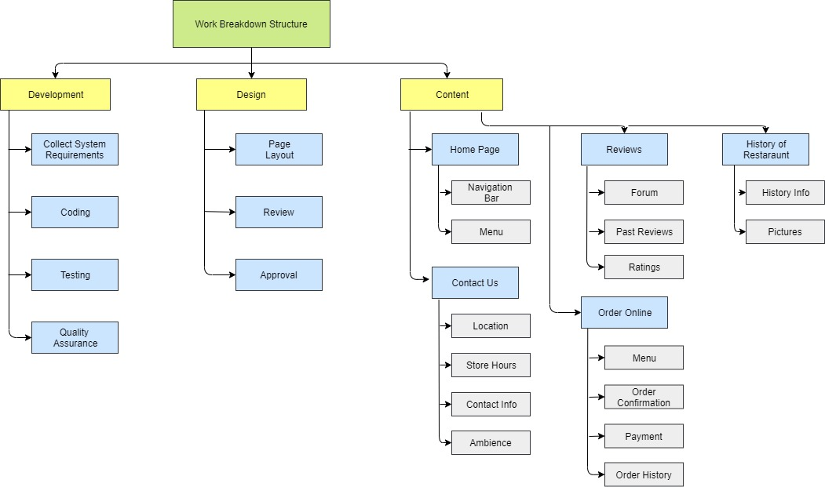
Work Breakdown Structure

Slide 11
Scrum Board Week 1
Scrum Week 1
To Do | Doing | Done
 | Creation of Home Page
Navigation Bar
Menu
 | Creation of Reviews Page
Forums
Past Reviews
Ratings
 | Creation of Contact Page
Location
Store Hours
Contact Information
Ambience
 | Creation of History Page
History Information
Pictures from the Past
 | Creation Order Online Page
Menu
Order Payment
Order Confirmation
Past Orders

Slide 12
Scum Board Week 2
Scrum Week 2
To Do | Doing | Done
 |  | Creation of Home Page
 | Navigation Bar
 | Menu
 |  | Creation of Reviews Page
 | Forums
 | Past Reviews
 | Ratings
 |  | Creation of Contact Page
 | Location
 | Store Hours
 | Contact Information
 |  | Creation of History Page
 | History Information
 | Pictures from the Past
 |  | Creation Order Online Page
 | Order Payment
 | Order Confirmation
 | Past Orders
Creation of Presentation
Design
Content

Slide 13
Scrum Board Week 3
Scrum Week 3
To Do | Doing | Done
 |  | Creation of Home Page
 |  | Navigation Bar
 |  | Menu
 |  | Creation of Reviews Page
 | Forums
 |  | Past Reviews
 |  | Ratings
 |  | Creation of Contact Page
 |  | Location
 |  | Store Hours
 |  | Contact Information
 |  | Creation of History Page
 | History Information
 | Pictures from the Past
 |  | Creation Order Online Page
 | Order Payment
 | Order Confirmation
 | Past Orders
 | Creation of Presentation
 | Design
 | Content

Slide 14
Thank you!

